Slide 1

Metro Interstate Traffic Volume Time Series Analysis for Minneapolis-St Paul, MN
Paritosh Rai
Rajesh Satluri
Notes:
Hi

Slide 2
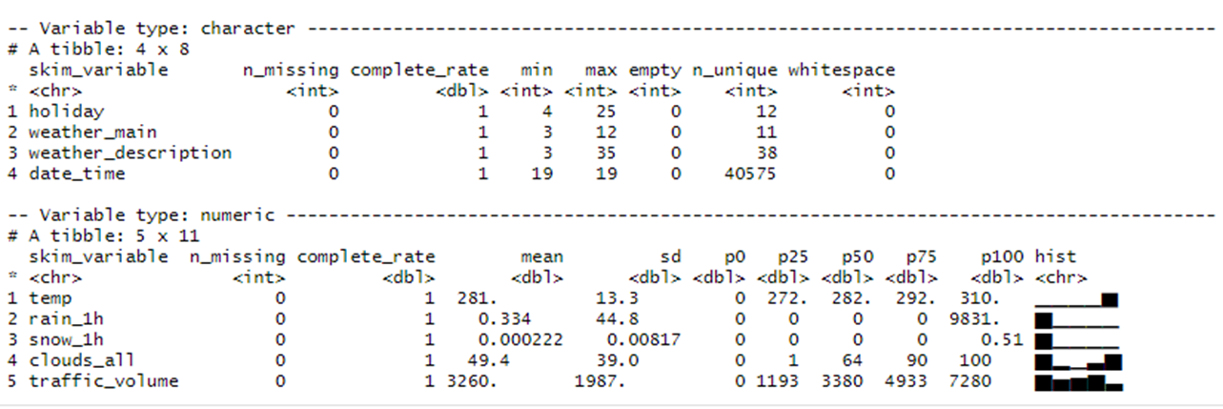

Dataset
(Who, What, When, Where, Why and How)
“This Dataset contains hourly data of Minneapolis-St Paul, MN traffic volume for westbound I-94.
It also includes weather and holiday features, and it has data between 2012-2018.”
This database had 3 Categorical, 5 numeric and one datetime variable with 48204 rows.
Rain and Snow is in mm and temperature is in Kelvin scale
This was a very clean data with no NA or missing data.
Based on domain knowledge values were in permissible limits
Header | Type | Description
Holidays | Categorical | US National holidays plus regional holiday, Minnesota State Fair
temperature | Numeric | Average Temperature in Kelvin scale
rain_1h | Numeric | Amount of Rain that occurred in the hour
snow_ih | Numeric | Amount in mm of snow that occurred in the hour
cloud_all | Numeric | Percentage cloud Covered in the hour
weather_Main | Categorical | Short textual description of the current weather
date_time | DateTime | Hour of the data collected in local CST time
traffic_volume | Numeric | Hourly 1-94 ATR 301 report Westbound traffic volume
Database will be leverage for two purposes:
User know how the traffic is going to be today, tomorrow or in few days to plan their travel
Leverage by highway authorities to plan the expansion of highway to manage the smooth traffic

Slide 3
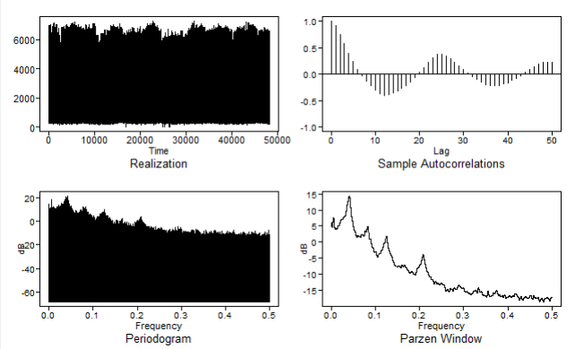
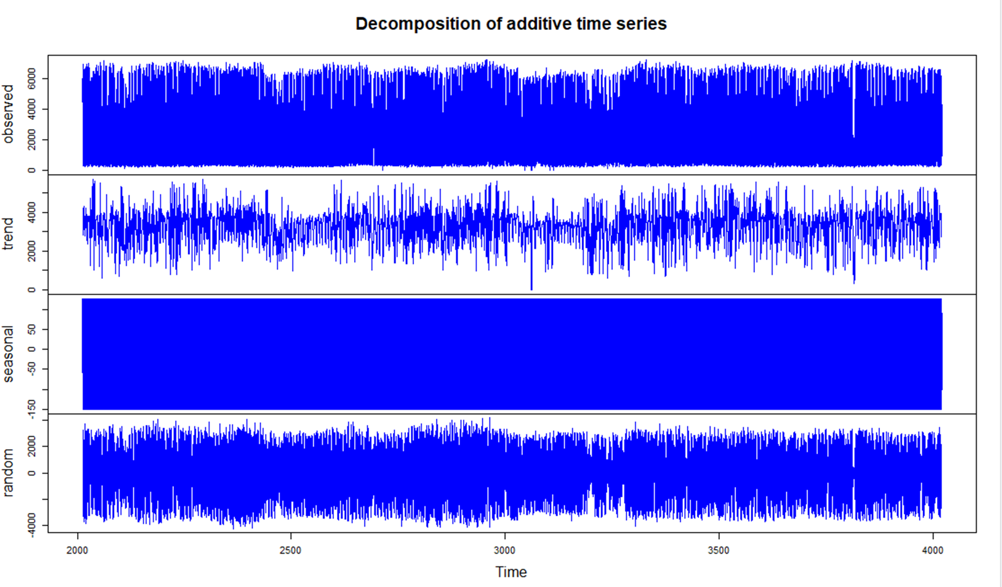
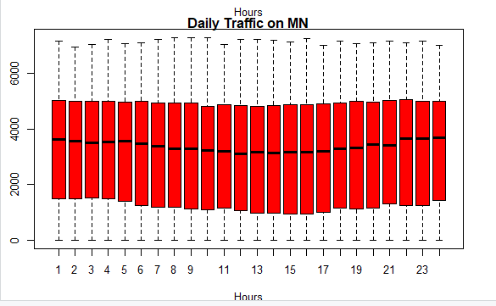
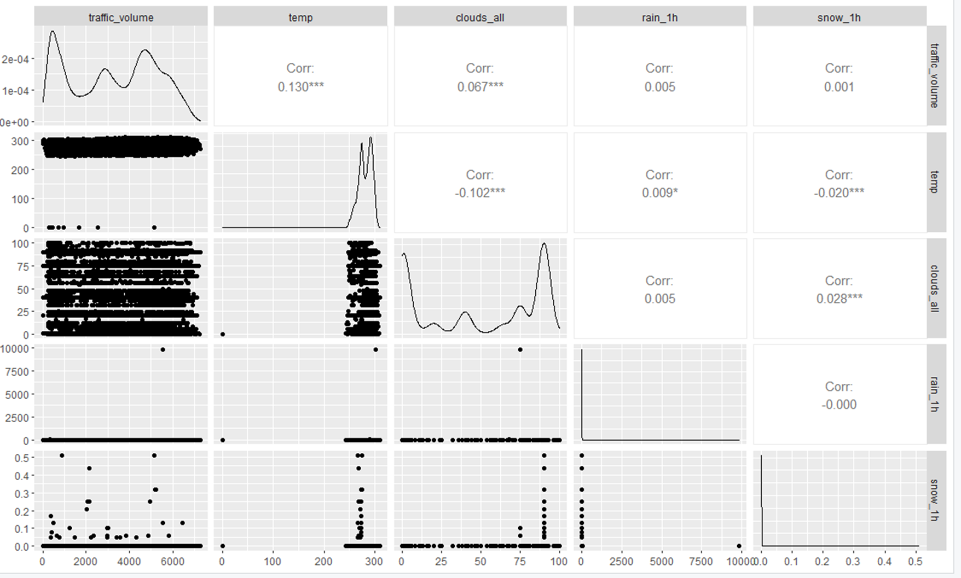
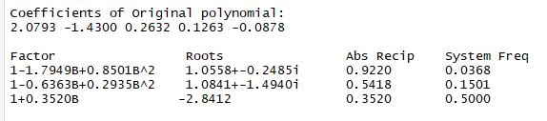
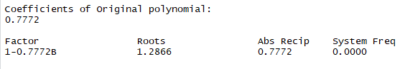
Exploring Data
Looking at roots, spectrum density, frequency model will be evaluated for seasonality with s= 2,12,24,27. However, no trend behavior is observed as non of the factors are near the unit circles, hence d = 0.
Realization shows seasonality with no trend
ACF is diminishing sinusoidal
Spectral density show few frequency peaks
Decompose time series support finding no trend
There is minor swings in traffic, in general traffic is balanced through out the day (24 hours)
Traffic show positive correlation with temperature ‘temp’ and ‘cloud_all’. Low to no correlation with other variables
Factors are outside unit circle so stationary model

Slide 4
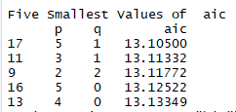
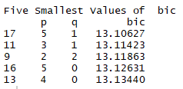
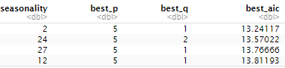
Model comparison with ase, aic and RWASE
Various seasonal and non-seasonal models were evaluated with ASE, AIC, and Rolling Window ASE. To derive the best, ARMA/ARIMA/ARUMA models, values of p, q, d and s were optimized
Lowest aic and bic value were derived with p =5 and q =1
Multiple model performance were evaluated based on AIC, ASE ( and ASE Rolling window):
Best Model for Short term is: p = 5, q = 2, d = 0 and s = 24 with ASE 497,735
Best Model for Long term is: p = 5, q = 1, d = 0 and s = 0 with ASE 3,829,925
p | q | D | s | nhead | AIC | ASE | ASE Rolling Window (RWASE) * (last 90 days data)
5 | 1 | 0 | 0 | 10 | 13.10627 | 867509 | 1.926e+17
5 | 1 | 0 | 0 | 1000 | 13.10627 | 3829925
5 | 1 | 0 | 2 | 10 | 13.24117 | 529529 | 9.471e+19
5 | 1 | 0 | 2 | 1000 | 13.24117 | 8466291
5 | 2 | 0 | 24 | 10 | 13.57022 | 497735 | 1.436e+21
5 | 2 | 0 | 24 | 1000 | 13.57022 | 8442857
5 | 1 | 0 | 27 | 10 | 13.76666 | 745992 | 3.607e+20
5 | 1 | 0 | 27 | 1000 | 13.76666 | 8611306
5 | 1 | 0 | 12 | 10 | 13.81193 | 1760584 | 7.121e+20
5 | 1 | 0 | 12 | 1000 | 13.81193 | 6150191
Best aic for different seasonal models
* Outcome of ASE rolling window was not aligning with visual outcomes. Possibly, analysis for ASE rolling window was ran on last 90 days due to large volume of data.

Slide 5
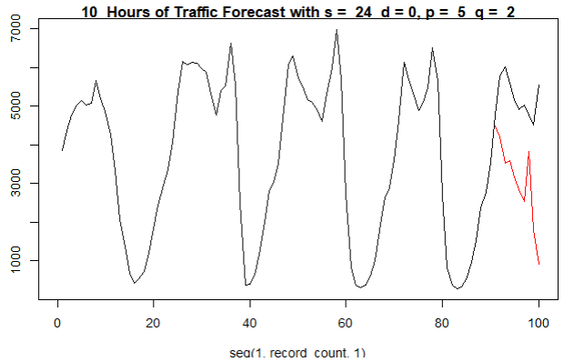
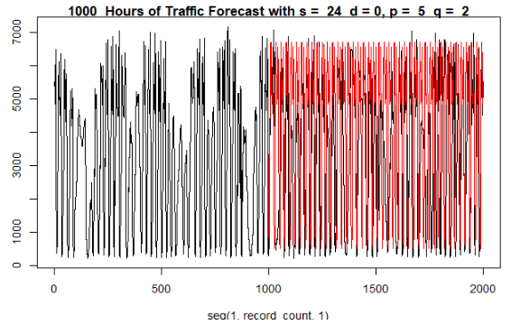
ASE Comparison - Long Term and shot term
Forecast for the LAST 10 hours of Traffic Volume with seasonal factor s=24, was our best short-term model.
For long term with seasonality 24 were chosen as best forecast. It visually looks very close to actual.
Comparison of actual vs. forecast for best seasonal short term (ASE = 497735)
Comparison of actual vs. forecast for best seasonal long term (ASE = 8442857)
Notes:
Forecast for the LAST 10 hours of Traffic Volume with seasonal factor s=24, with AR p value 5 and MA q is equal to 2 was our best short-term model.
for long term ( to forecast LAST 1000 hours) , we choose with seasonality 24 as best forecast because visually looks very close to actual realization. But we will further investigate this behavior.

Slide 6
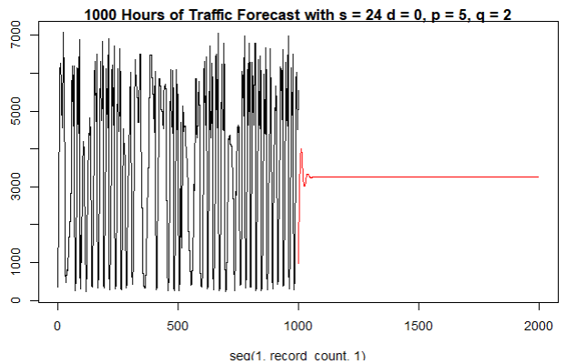
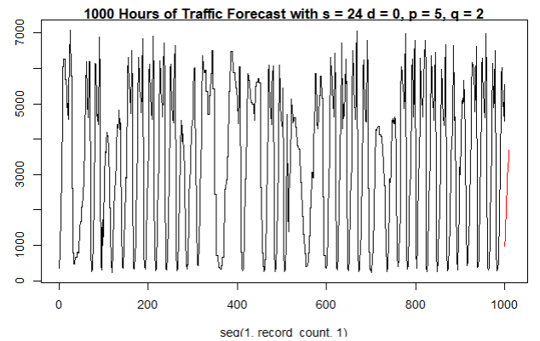
long-term and short-term forecast
As expected, long-term forecast trends towards mean as model do not have trend.
Short-term model aligns with the expected forecast.
Comparison of actual vs. forecast for best seasonal short term (ASE = 497735)
Comparison of actual vs. forecast for best seasonal long term (ASE = 8442857)
Notes:
As expected, long-term forecast trends towards mean as model do not have trend.
Short-term model aligns with the expected forecast.

Slide 7
Strategy/ plans for Next Steps
Team will continue to reevaluate the data and perform multivariable analysis using VAR and Neural Network models by incorporating the dependent variables to derive possibly better forecasting.
Identify most corelated variables with Traffic Volume
Create models using VAR, Neural Network and others
Compare and contrast with all the models and recommend the models specific to applications
Notes:
We will continue to reevaluate the data and perform multivariable analysis using VAR and Neural Network models by incorporating the dependent variables to derive possibly better forecasting.

Slide 8

THANK YOU
.
.

